Slide 1
20XD24 - OBJECT ORIENTED PROGRAMMING Chapter – II Classes and Objects

Slide 2
Outline
Classes and Objects
Member functions
Nesting of Member functions
Private member functions
Memory allocation for Objects
Static data members - Static Member Functions
Array of Objects
Objects as Function Arguments
Friend Functions
Returning Objects
Const Member functions
Pointers to Members

Slide 3
Classes and Objects
Class is a new data type which is used to define objects. A class serves as a plan, or a template
It specifies what data and what functions will be included in objects of that class. Writing a class doesn’t create any objects
A class is a description of similar objects
Objects are instances of classes
Syntax : Class declaration
class class-name
{
data-member declarations;
member-function declarations or definitions;
};

Slide 4
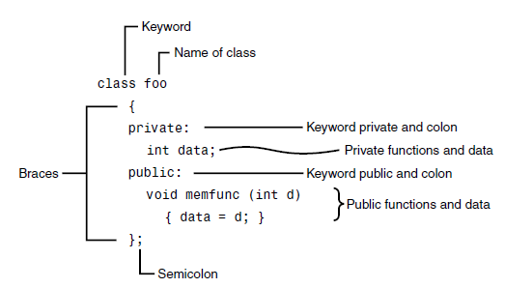

Classes and Objects

Slide 5
Classes and Objects
Data Members
A class normally consists of one or more member functions that manipulate the attributes that belong to a particular object of the class
Attributes are represented as variables in a class definition. Such variables are called data members and are declared inside a class definition but outside the bodies of the class’s member-function definitions
Member functions
Member functions are functions that are included within a class
Member function can be defined either inside or outside the class

Slide 6
Classes and Objects
If the member function is declared inside the class, then its definition is given outside the class
Syntax to define the member function outside the class:
return-type classname::function-name(argument list)
{ ……
…… //function body
};
Membership label classname:: tells the compiler that function function-name belongs to classname:: specified in header line
Symbol :: is called scope resolution operator

Slide 7
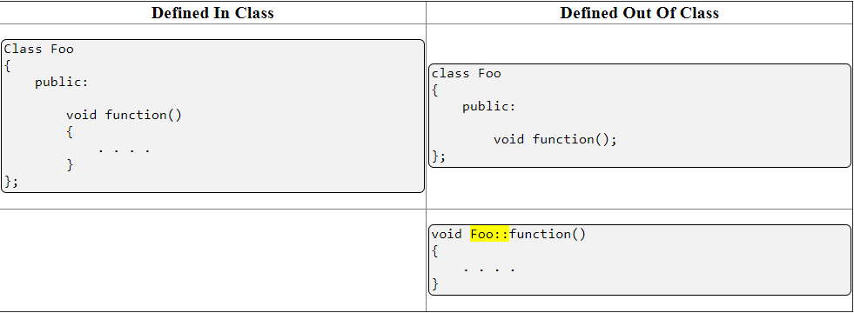
Classes and Objects
Functions defined inside of a class are inlined by default
Functions that are prototyped in the class but defined outside of the class must be bound to the class with the class name and the scope resolution operator (highlighted in yellow)

Slide 8
Scope Resolution Operator (::)
Unary scope resolution Operator
Hidden global variables can be accessed
Hidden local variables cannot be accessed
int a=10;
main()
{
int a = 20;
{
int a=30;
cout<<a; //30
cout<<::a; //10
}
cout<<a; //20
cout<<::a; //10
}

Slide 9
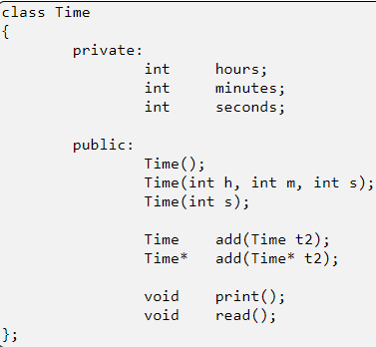
Classes and Objects
All features included in a class specification are called "members" of the class, which results in two important terms:
Data members (or) Member variables
Variables defined in class scope. For example: hours, minutes, and seconds
Member functions
Functions defined in class scope.
For example: add(), print(), and read()

Slide 10
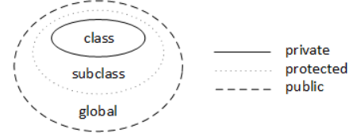
Classes and Objects
Access Specifiers : Members (both data members and member functions) of a class can be declared as
Private - visible only inside the class – default for class members
Protected - private + visible to the immediately derived class
Public - globally visible
Note :
A class may have any number of public and private sections in any order
As a rule of thump, data members are declared private and member functions are declared public

Slide 11
Classes and Objects
Class members are private by default
class point
{
int x, y;
};
int main()
{
point p1;
p1.x=10; // error
}
class point
{
public:
int x, y;
};
int main()
{
point p1;
p1.x=10; // correct
}

Slide 12
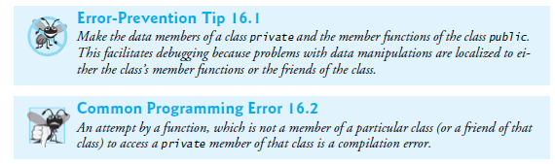
Classes and Objects
struct vs class
The only real difference between a struct and a class is the default visibility
structs have public visibility by default and
classes have private visibility by default

Slide 13
Classes and Objects
Member variables of a class define the properties or characteristics of an object
Member variables may be
Static
Non-static
Reference
Pointer
Const
Member functions of a class - define actions or behavior of an object
Member functions may be
Constructors
Destructors
Static functions
Non-static functions
Const functions
Virtual functions

Slide 14
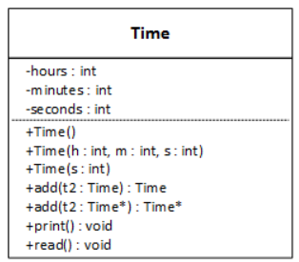
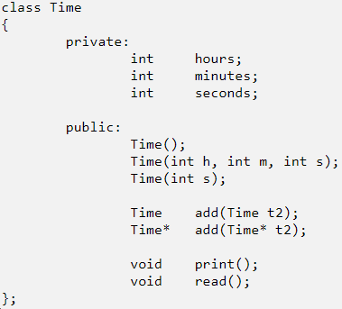

Classes and Objects
The UML (Unified Modeling Language) Class Symbol

Slide 15
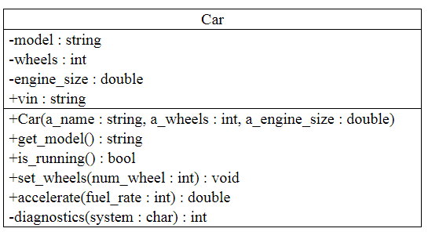
Classes and Objects
Test Yourself: Translating Basic UML to C++

Slide 16
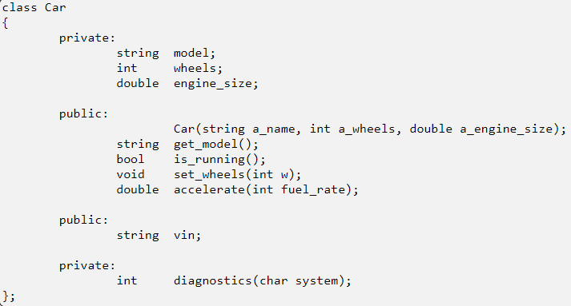
Classes and Objects
Version 1: Variables and Functions Separate

Slide 17
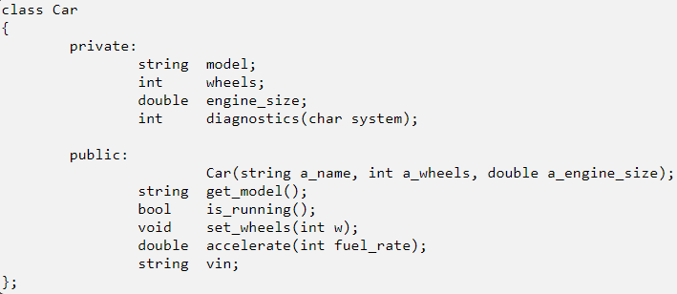
Classes and Objects
Version 2: Private and Public Features Together

Slide 18
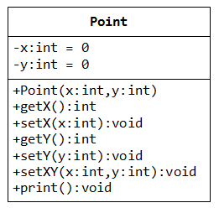
Classes and Objects
Creating Objects - instantiation
An object is an instance of a class
It is defined just like other variables
Syntax : Classname Objectname;
Example
Point P1, P2;
It can access members using dot operator
P1. print();
P1.gety();
P1 P2
0
0
0
0

Slide 19
Classes and Objects
Defining Member Functions
Member functions are part of a class declaration
Place entire function definition inside the class declaration (or)
Place just the prototype inside the class declaration and write the function definition after the class
Types of Member Functions
Acessor, get, getter function: uses but does not modify a member variable
ex: getX
Mutator, set, setter function: modifies a member variable
ex: setXY

Slide 20
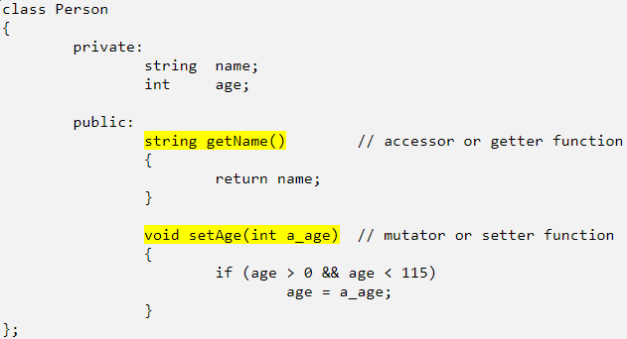
Classes and Objects

Slide 21
Classes and Objects
Member functions defined inside the class declaration are called inline functions
Example
class Square
{
private:
int side;
public:
void setSide(int s)
{ side = s; }
int getSide()
{ return side; }
};
inline functions

Slide 22
Classes and Objects
Defining Member Functions After the Class Declaration
Write a function prototype in the class declaration
In the function definition, precede the function name with the class name and scope resolution operator (::)
int Square::getSide()
{
return side;
}

Slide 23
Nesting of Member Functions
A member function can call another member function of the same class directly without using the dot operator. This is called as nesting of member functions
class set
{
int m, n;
public:
void get() { cin>>m>>n;}
void display();
int largest();
};
void set :: display()
{ cout<<largest();
}
int set::largest()
{
if(m<=n)
return m;
else
return n;
}
main()
{ set s1;
s1.get();
s1.display();
}

Slide 24
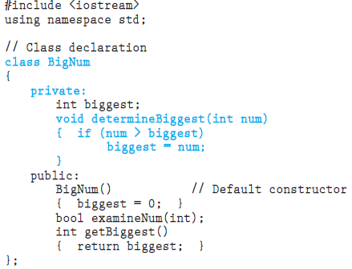
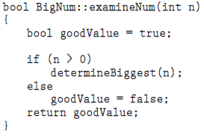
Private Member Functions
Sometimes a class may need functions that are necessary for internal processing, but that client programs using the class do not need and should not be allowed to use
These functions may even access data that should be hidden from programs outside the class. Such functions should be made private

Slide 25
Classes and Objects
class account
{
private:
int acc_no;
char name[25];
float balance;
public:
void read()
{ cin>>acc_no>>name>>balance;
}
void withdraw(float amt) // member function defined inside a class
{ balance-=amt;
}
void deposit();
};
void account::deposit() // member function defined outside a class
{ float amt; // using binary scope resolution operator
cin>>amt;
balance += amt;
}
main()
{ account a1,a2;
a1.read();
a2.read();
a1.withdraw(1000);
a2.deposit();
}

Slide 26
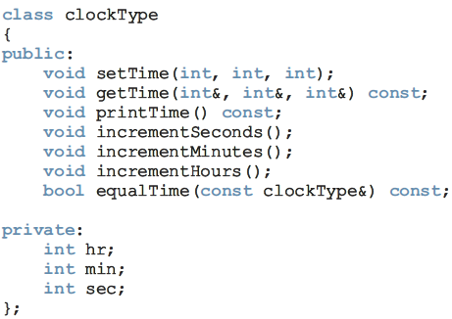
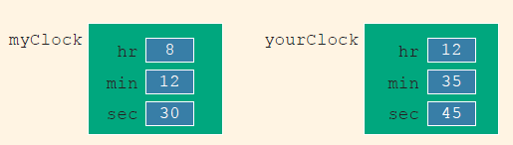
Memory Allocation for Objects
clockType myClock;
clockType yourClock;
In actuality, memory is allocated only for the member variables of each class object
The C++ compiler generates only one physical copy of a member function of a class, and each class object executes the same copy of the member function

Slide 27
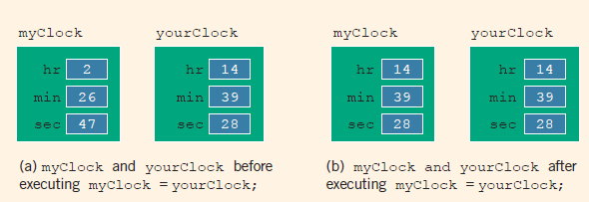
Assignment Operator
myClock = yourClock; //Line 1
The values of the three member variables of yourClock are copied into the corresponding member variables of myClock. Therefore, an assignment statement performs a member-wise copy

Slide 28
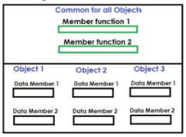
Memory Allocation for Objects
Note :
Only declaration of a class does not allocate memory to the class data members
When an object is declared, memory is reserved for data members and not for member functions
Member functions are created and memory is allocated to them only once when a class is declared
All objects of the class access the same memory location where member functions are stored

Slide 29
‘this’ Pointer
Whenever a member function is called, it must be called through or bound to an instance of the class that defines the function
Whenever a member function is called, the address of the calling object is automatically passed as an "invisible" or implicit pointer argument
The "this" pointer is an automatic local variable that the compiler generates in every non-static member function and that stores the address of the object that calls the member function

Slide 30
‘this’ Pointer
‘this’ is the keyword can be used inside the class, which represents the current object’s address
When a member function is called, it is automatically passed as an implicit argument
class account
{
int acc_no;
public:
void assign(int acc) // void assign(int acc_no)
{ //{
acc_no=acc; // this->acc_no=acc_no;
} //}
};

Slide 31
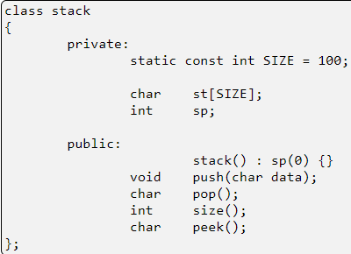
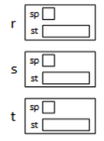
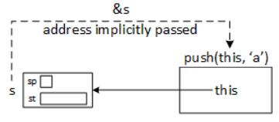
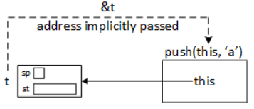

Visualizing The ‘this’ Pointer
stack r;
stack s;
stack t;

Slide 32
‘this pointer’
Note:
The this pointer is a pointer accessible only within the nonstatic member functions of a class, struct, or union type
It points to the object for which the member function is called
An object's this pointer is not part of the object itself
The expression *this is commonly used to return the current object from a member function
return *this;
Type of the this pointer
‘this’ pointer is always a const pointer. It can't be reassigned
class-type * const this

Slide 33
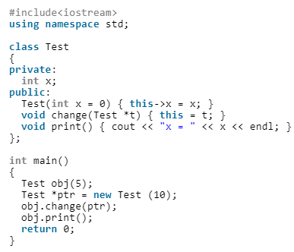
‘this’ pointer
‘this’ is a const pointer, so there is an error in line this = t;

Slide 34
‘this’ pointer
// C++ program to show that local parameters hide class members
#include <iostream>
using namespace std;
class Test {
int a;
public:
Test() { a = 1; }
// Local parameter 'a' hides class member 'a'
void func (int a) { cout << a; }
// void func (int a) { cout<<this->a; } output : 1
};
int main()
{
Test obj;
int k = 3;
obj.func(k);
return 0;
}
Output
3

Slide 35
Array of Objects
Elements of arrays can be class objects
main()
{
player cricket[3];
cout<<“Enter name and age of 3 players”;
for (int i=0;i<3;i++)
cricket[i].getdata();
for (int i=0;i<3;i++)
cricket[i].putdata(); }
class player
{ char name[20];
int age;
public:
void getdata(void);
void putdata(void);
};
void player::getdata()
{
cout<<“\n Enter name: ”;
cin>>name;
cout<<“\n Enter age: ”;
cin>>age;
}
void player::putdata()
{
cout<<“\n Player name: ”<<name;
cout<<“\n Player age: ”;<<age;
}
Ram
25
Bala
27
Sree
22
Name
cricket[0]
}
age
Name
cricket[1]
}
age
Name
}
cricket[2]
age

Slide 36
Static Data Members
A Static Data Member is a single shared object to all objects of its class
class SavingsAccount
{
public:
SavingsAccount();
void earnInterest();
{
total+=CurrentintRate*total;
}
private:
char name[30];
float total;
float CurrentintRate;
};
Each object is having its own
copy of CurrentintRate
Waste of space
Has to update changes
Inefficient
Lead to Inconsistencies
Not Advisable

Slide 37
Static Data Members
class SavingsAccount
{
public:
SavingsAccount();
void earnInterest();
{
total+=CurrentintRate*total;
}
private:
char name[30];
float balance;
float CurrentintRate;
}s[5];
S[0]
S[1]
S[2]
S[3]
S[4]
name
Ram | Bala | Shri | Maya | Dhiya
5000 | 6000 | 3000 | 8000 | 9000
0.5 | 0.5 | 0.5 | 0.5 | 0.5
balance
CurrentintRate

Slide 38
Static Data Members
Why not Global Variable?
Problem : Scope
Every function will be able to modify its value
Requirement
Solution
A Kind of Global variable for an
individual class
All objects of a particular class
access the same variable
Static Data Members have only
one copy of it allocated
No matter how many instances
of the class
Data Member made static by
prefixing with “static” keyword

Slide 39
Static Data Members
Static Data members may seem like global variables, but
have class scope
Shared by all objects
Object B
RateofInt = 0.5
Object A
cur_bal=5000
cur_bal=1500

Slide 40

Static Data Members
S[0]
S[1]
S[2]
S[3]
S[4]
class SavingsAccount
{
public:
SavingsAccount();
void earnInterest();
{
total+=CurrentRate*total;
}
private:
char name[30];
float total;
static float CurrentintRate;
}S[5];
float SavingsAccount :: CurrentintRate = 0.5;
name
Ram | Bala | Shri | Maya | Dhiya
5000 | 6000 | 3000 | 8000 | 9000
total
0.5
CurrentintRate
Declaration
Definition

Slide 41
Static Data Members
// Assume that integers take 4 bytes
#include<iostream>
using namespace std;
class Test
{
static int i;
int j;
};
int Test :: i;
int main()
{
cout << sizeof(Test);
return 0;
}
Output:
4

Slide 42
Static Data Members
A static data member
Is associated with class not with object
Is shared by all the objects of a class
Needs to be defined outside the class scope (in addition to the declaration within the class scope)to avoid linker error
Must be initialized in a source file
Is constructed before main() starts and destructed when main() ends
Can be public/private
Can be accessed
With the class-name followed by the scope resolution operator (::)
As a member of any object of the class
Virtually eliminates any need for global variables in OOPs environment

Slide 43
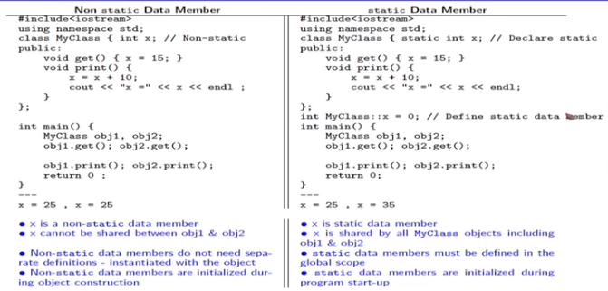
Static vs Non-static Data Members

Slide 44
Static Data Members
A static member can be public, making visible to the rest of the program
If CurrentintRate were a public member, one could access it as follows :
It implies that only CurrentintRate of myaccount is being modified
int main()
{
SavingsAccount myaccount;
myaccount.CurrentintRate = 0.050;
// SavingsAccount :: CurrentintRate = 0.050;
}

Slide 45
Static Data Members
A static data member is initialized outside the class definition in the same manner as a Non-member variable
The only difference is that the class scope operator syntax
must be used
Only one initialization of a static data member can occur within a
program
int main()
{
float SavingsAccount::CurrentintRate = 0.050;
}

Slide 46
Static Data Members
Static member initializations should be placed in a file together with
the definitions of the inline member functions and not in the class
header file
# include “savings.h”
float SavingsAccount::CurrentRate = 0.050;
SavingsAccount::SavingsAccount()
{
CurrentintRate = 0.050;
// Cannot initialize a static member from within a constructor
// Because constructor may be called many times
}

Slide 47
Static Data Members
A static data member can appear as a default argument to a member function of the class
A non static member cannot
extern int a;
class foo
{
private:
int a;
static int b;
public:
int mem1(int = a); // ERROR.. There is no associated
class object
int mem2(int = b); // OK
int mem3(int = ::a); // OK
};

Slide 48

Static Member Functions
A “Static Member Function” is a member function that accesses only the Static data members of a class
class SavingsAccount
{
public:
SavingsAccount();
void earnInterest()
{ total+=CurrentRate*total; }
static void setinterest(float new_value)
{ CurrentintRate = new_value; }
private:
char name[30];
float balance;
float CurrentintRate;
};

Slide 49

Static Member Functions
A static member function may be invoked through a class object or a pointer to a class object similar to a non static member function
int main()
{
SavingsAccount myaccount;
myaccount.setinterest(0.50);
SavingsAccount::setinterest(0.50);
}
A static member function does not contain a this pointer, since a static member function doesn’t act on any particular instance of the class
A static member function
can’t access any of the class’s non static data members or call any non static member functions

Slide 50

Static vs. Non-static Member Functions
Static Member Function | Non-Member Function
Can be called even when a class is not instantiated | Can be called only after instantiating the class
Can access only static members of the class | Can access all members of the class including static data member
Cannot have access to the ‘this’ pointer of the class | By default ‘this’ pointer is available

Slide 51
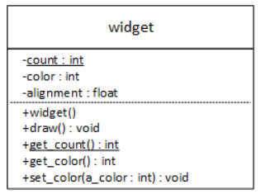
Static and UML Diagrams
The UML denotes static features by underlining them
The underlining is translated into the static keyword when the UML class diagram is translated into C++

Slide 52
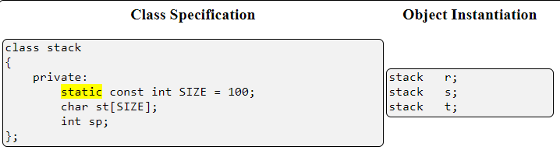
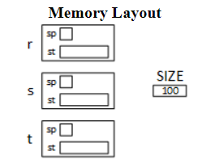
Static Example
Note:
Using both the static and the const keywords creates a symbolic constant that belongs to a class, and C++ has long supported this syntax
Member variables that are static but not constant can not be initialized inside the class
Static but non-const variables must be defined outside of the class, but their definition must still be tied to the class in which they are declared

Slide 53
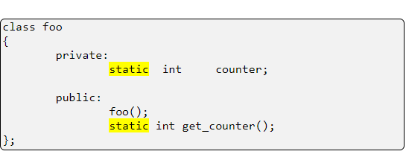
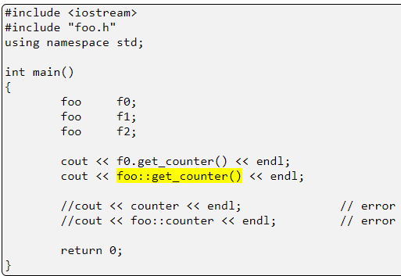
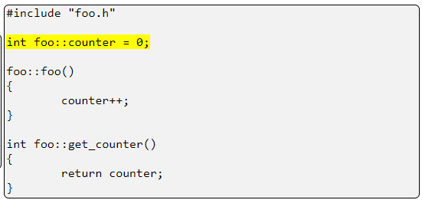
Static Member Function

Slide 54
Friend Functions
The concepts of encapsulation and data hiding dictate that nonmember functions should not be able to access an object’s private or protected data
However, there are situations where such rigid discrimination leads to considerable inconvenience
MUST be declared as a friend in the friending class's specification
are NOT members of the class that declares them as a friend
nevertheless have access to the friending class's private features
defined outside of the class do NOT include the class name and scope resolution operator as a part of the class name
are NOT called with the dot operator: object.function();
can be declared as friends of more than one class and when used this way are called bridge functions
are controversial because they weaken encapsulation
strengthen some overloaded operators by allowing them to perform useful tasks not otherwise possible

Slide 55
Friend Functions
Include its prototype in the class
Syntax
friend returntype function_name ( arguments);
Can be declared anywhere (in public, protected or private section)
May or may not take arguements
Objects of the class or their pointers can be passed as arguments to the friend function

Slide 56
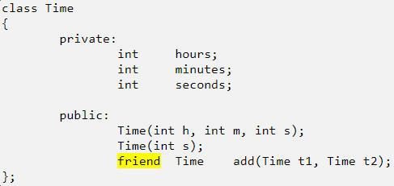
Friend Functions
The friend keyword only appears in the class specification
This approach prevents arbitrary functions from becoming friends and gaining access to a class's private features

Slide 57
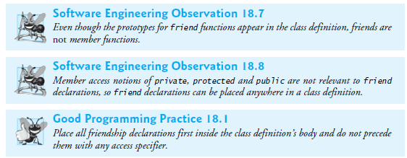
Friend Functions

Slide 58
Friend Functions Example
include <iostream>
using namespace std;
class Box {
double width;
public:
friend void printWidth( Box b );
void setWidth( double wid );
};
void Box::setWidth( double wid ) {
width = wid;
}
void printWidth( Box b ) {
cout << "Width of box : " << b.width <<endl;
}
main()
{
Box b1;
b1. setWidth( 10.5 ) ;
printWidth( b1 );
}

Slide 59
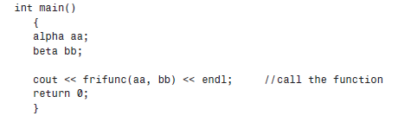
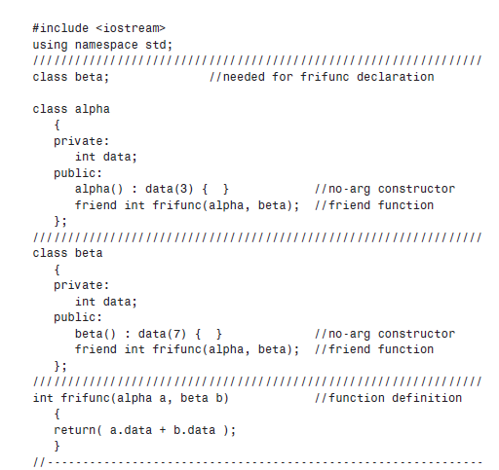
Function as Friend of More than One Class
aa
3
bb
7

Slide 60
Friend Functions
Member functions one class can be friend functions of another class
Example
#include <iostream>
using namespace std;
class A; // forward declaration of A needed by B
class B
{ public:
void display(A obj); //no body declared
};
class A
{
int x;
public:
A() { x = 4; }
friend void B::display(A);
};
void B::display(A obj)
{ cout << obj.x << endl; }
class foo
{
public:
int func1();
….
};
class Bar
{
friend int foo::func1();
};
int main()
{ A a;
B b;
b.display(a);
return 0;
}

Slide 61
Friend Class
Entire class can be declared as friend for another class
When a class is declared as friend, it means the members of the friend class have access to all the public / private / protected members of the class in which the declaration was made
Friendship is granted, not taken—i.e., for class B to be a friend of class A, class A must explicitly declare that class B is its friend
Note:
Friendship relation is not Symmetric
If class A is a friend of class B, you cannot infer that class B is not a friend of class A
Friendship relation is not Transitive
if class A is a friend of class B, and class B is a friend of class C, you cannot infer that class B is a friend of class A
Friendship is not inherited

Slide 62
Friend Class Example
#include <iostream>
using namespace std;
class two;
class one
{ int a1,b1;
public:
assign(void)
{ a1=5, b1=10; }
friend class two;
};
class two
{
int a,b;
public:
void let(int x, int y)
{ a=x; b=y; }
void print(void)
{ cout<<"a="<<a<<"b="<<b; }
void assign(one &x)
{ a=x.a1;
b=x.b1;
}
};
void main(void)
{ one o1;
two t1;
o1.assign();
t1.let(4,2);
t1.print();
t1.assign(o1);
t1.print();
}
o1
a1
5
10
x(alias name)
b1
t1
a
4
2
b
a = 4 b= 2
a= 5 b=10

Slide 63
Objects as Function Arguments
Objects as function arguments
Objects can be passed as function argument in two ways
Only the address of the object is passes (pass by address / reference)
class Time
{
int hrs, mins;
public:
void set(int h, int m)
{ hrs = h; mins = m; }
void show( )
{ cout<<hrs << mins; }
void sum ( Time &t)
{ hrs += t.hrs;
mins += t.mins; }
};
main()
{
Time t1(10, 20), t2(11, 30);
t1.show();
t2.show();
t1.sum(t2);
t1.show();
t2.show();
}
t1
hrs
10
20
mins
t2
hrs
11
30
mins

